Slide 1


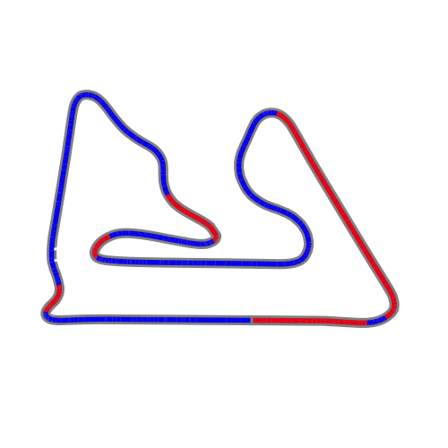


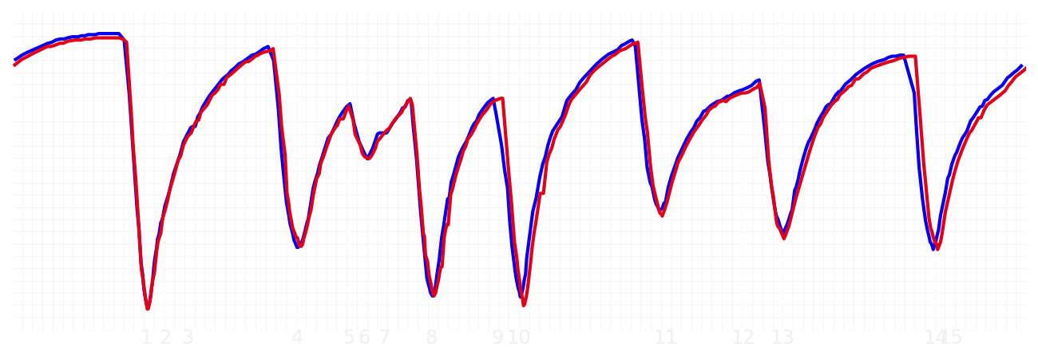
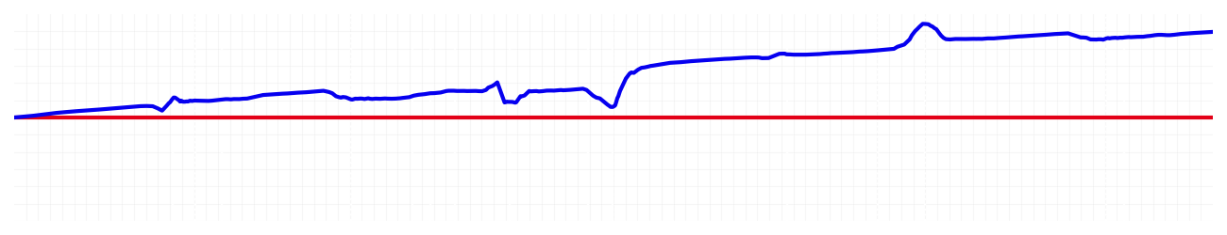
Bahrain GP Qualifying Q3
Max Verstappen
Driver
Yuki Tsunoda
Driver
Lap Time
01:30.423
01:31.303
Lap Time
Sector 1
28.880
Speed Trap 1
243 kp/h
Speed Trap 1
242 kp/h
Sector 1
29.026
Sector 2
38.855
Speed Trap 2
274 kp/h
Gap
-0.88
Gap
0.88
Speed Trap 2
272 kp/h
Sector 2
39.377
Sector 3
22.688
Speed Final Line
288 kp/h
Corner Advantage
4/16
Corner Advantage
12/16
Speed Final Line
286 kp/h
Sector 3
22.900
FULL THROTTLE
62%
61%
FULL THROTTLE
HEAVY BREAKING
17%
17%
HEAVY BREAKING
%LAP TIME
CORNERING
21%
22%
CORNERING
%LAP TIME
SPEED
SPEED
DELTA TIME
DELTA TIME

Slide 2

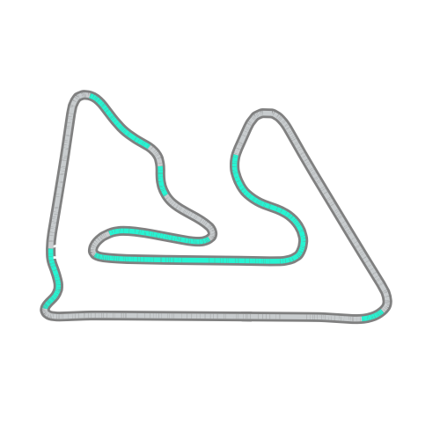


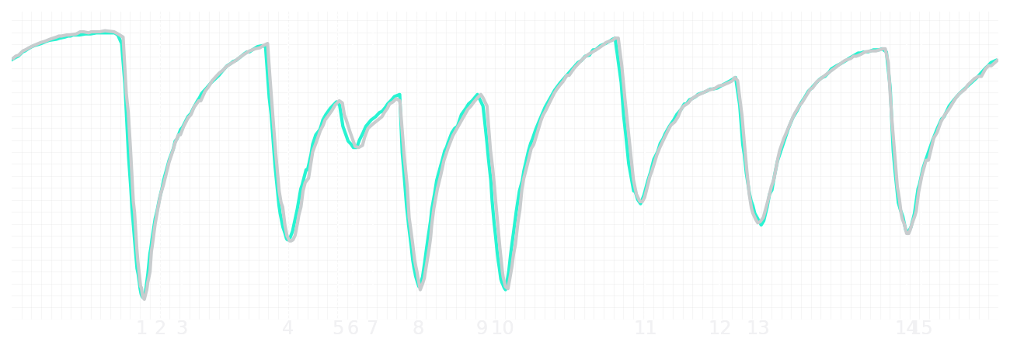
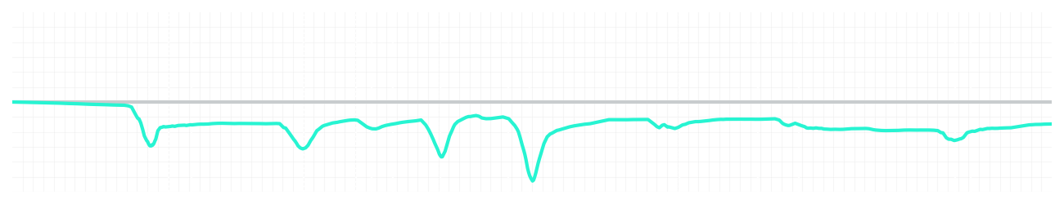
Bahrain GP Qualifying Q3
Kimi Antonelli
Driver
George Russell
Driver
Lap Time
01:30.213
01:30.009
Lap Time
Sector 1
28.836
Speed Trap 1
244 kp/h
Speed Trap 1
243 kp/h
Sector 1
28.771
Sector 2
38.786
Speed Trap 2
273 kp/h
Gap
0.204
Gap
-0.204
Speed Trap 2
274 kp/h
Sector 2
38.710
Sector 3
22.591
Speed Final Line
288 kp/h
Corner Advantage
7/16
Corner Advantage
9/16
Speed Final Line
289 kp/h
Sector 3
22.528
FULL THROTTLE
64%
63%
FULL THROTTLE
HEAVY BREAKING
20%
19%
HEAVY BREAKING
%LAP TIME
CORNERING
16%
18%
CORNERING
%LAP TIME
SPEED
SPEED
DELTA TIME
DELTA TIME

Slide 3

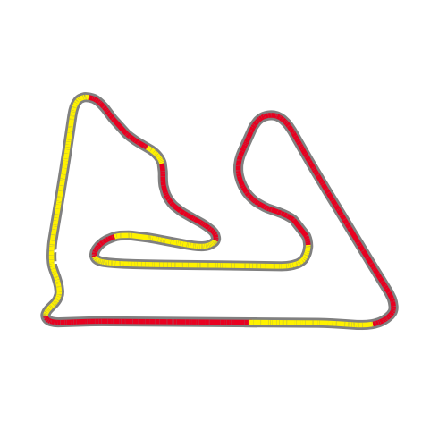


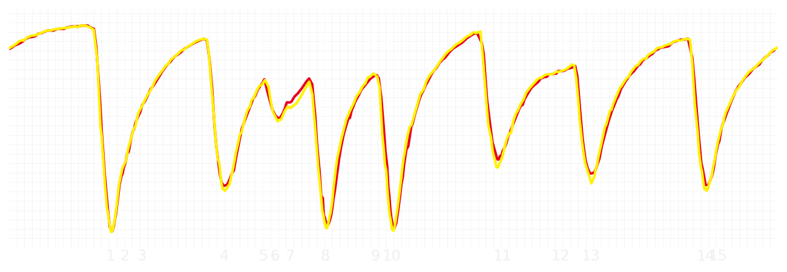
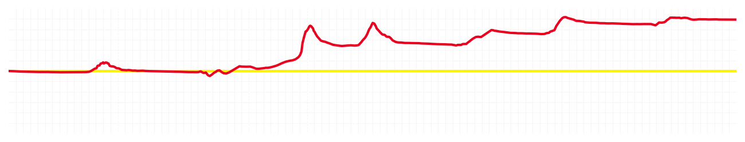
Bahrain GP Qualifying Q3
Charles Leclerc
Driver
Lewis Hamilton
Driver
Lap Time
01:30.175
01:30.772
Lap Time
Sector 1
28.926
Speed Trap 1
243 kp/h
Speed Trap 1
243 kp/h
Sector 1
28.955
Sector 2
38.714
Speed Trap 2
271 kp/h
Gap
-0.597
Gap
0.597
Speed Trap 2
271 kp/h
Sector 2
39.058
Sector 3
22.535
Speed Final Line
289 kp/h
Corner Advantage
7/16
Corner Advantage
9/16
Speed Final Line
289 kp/h
Sector 3
22.759
FULL THROTTLE
59%
62%
FULL THROTTLE
HEAVY BREAKING
19%
21%
HEAVY BREAKING
%LAP TIME
CORNERING
22%
17%
CORNERING
%LAP TIME
SPEED
SPEED
DELTA TIME
DELTA TIME

Slide 4

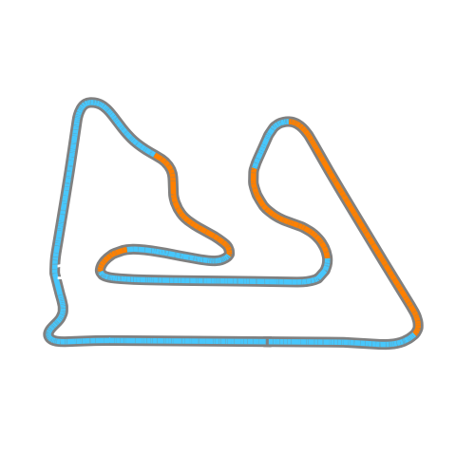


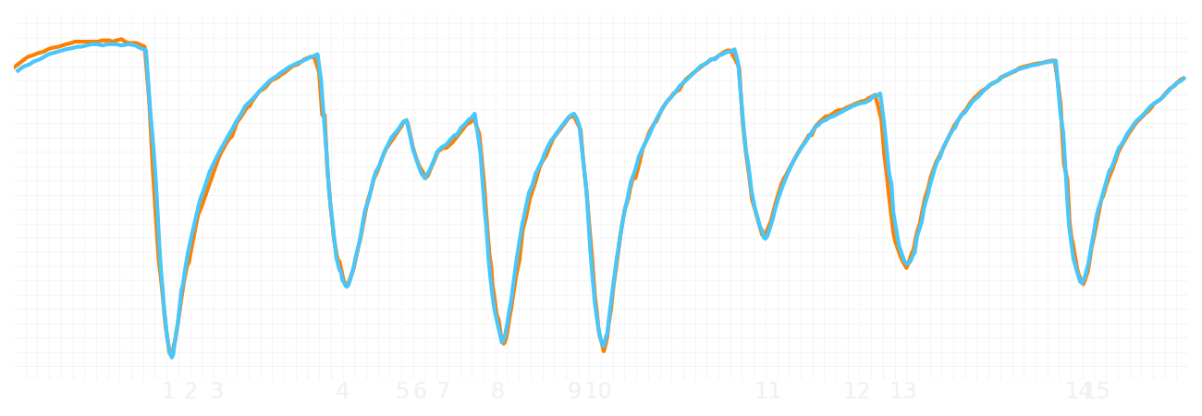
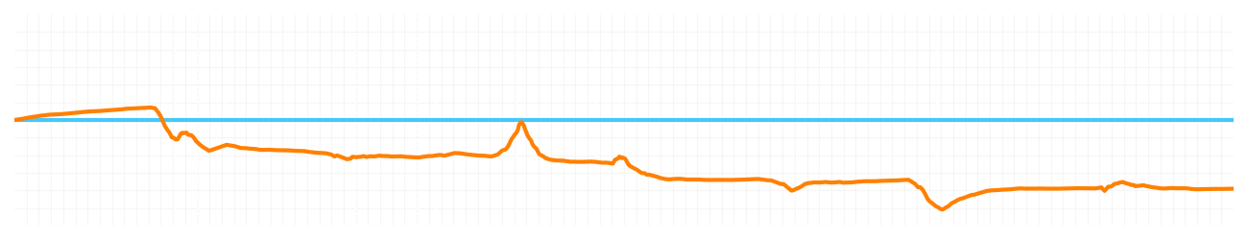
Bahrain GP Qualifying Q3
Lando Norris
Driver
Oscar Piastri
Driver
Lap Time
01:30.267
01:29.841
Lap Time
Sector 1
29.007
Speed Trap 1
242 kp/h
Speed Trap 1
243 kp/h
Sector 1
28.784
Sector 2
38.678
Speed Trap 2
274 kp/h
Gap
0.426
Gap
-0.426
Speed Trap 2
273 kp/h
Sector 2
38.574
Sector 3
22.582
Speed Final Line
286 kp/h
Corner Advantage
10/16
Corner Advantage
6/16
Speed Final Line
286 kp/h
Sector 3
22.483
FULL THROTTLE
63%
61%
FULL THROTTLE
HEAVY BREAKING
18%
18%
HEAVY BREAKING
%LAP TIME
CORNERING
19%
21%
CORNERING
%LAP TIME
SPEED
SPEED
DELTA TIME
DELTA TIME

